Slide 1

DEPARTMENT OF COMPUTER SCIENCE ALIGARH MUSLIM UNIVERSITY, ALIGARH
Week #2
5# Presentation (CAMS-1P01)
Climate Change
Presented By
Mohd Rameez Khan

Slide 2
Table Of Contents
1. Introduction
2. Climate Change Infographic
3. Debunking Myths
Risk and Reversing Factors
Conclusion

Slide 3
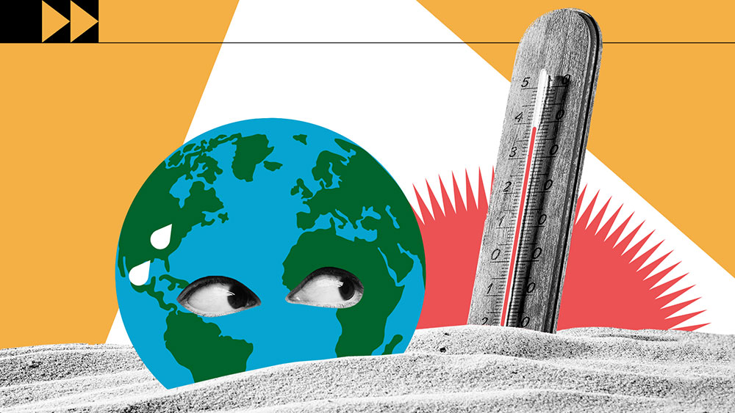
1. Introduction
Climate change refers to long-term shifts in temperatures and weather patterns.
Since the 1800s, human activites have been the main driver of climate change, primarily due to the burning of fossil fuels like coal, oil and gas.
Burning fossil fuels generates greenhouse gas emissions that act like a blanket wrapped around the Earth, trapping the sun’s heat and raising temperatures.
The main greenhouse gases that are causing climate change include carbon dioxide and methane.
These come from using gasoline for driving a car or coal for heating a building, for example.
Energy, industry, transport, buildings, agriculture and land use are among the main sectors causing greenhouse gases.

Slide 4
2. Climate Change Infographic

Slide 5
3. Debunking Myths
Myth | Fact
Climate change has always happened, so we should not worry about it. | The Earth is heating up at its fastest rate in at least 2,000 years and is about 1.2°C hotter than it was in pre-industrial times.
Climate change is a natural process. It has nothing to do with people. | While climate change is a natural process human activity is pushing it into overdrive.
A couple of degrees of warming is not that big of a deal. | Actually, small temperature rises can throw the world’s delicate ecosystems into disarray, with dire implications for humans and other living things.
It is too late to avert a climate catastrophe, so we might as well keep burning fossil fuels. | While the situation is dire, there is still a narrow window for humanity to avoid the worst of climate change.
We do not need to worry about lowering greenhouse gas emissions. Humanity is inventive; we can just adapt to climate change. | Some countries and communities can adapt to rising temperatures, lower precipitation and the other impacts of climate change. But many cannot.

Slide 6
4. Cause and Reversing Factors
Causes Of Climate Change
Generating power
Manufacturing goods
Cutting down forests
Using transportation
Producing food
Powering buildings
Consuming too much
Reversing Factors
Phase Out Damaging Refrigerants
Install Onshore Wind Turbines for Generating Power
Reduce the Nation’s Food Waste
Shift to a Plant-Rich Diet
Restore the Tropical Forests of the World
Design Smarter Cities for Transit
Make Solar Photovoltaics an Energy Priority

Slide 7

5. Conclusion
Climate change is an undeniable crisis that demands immediate and concerted global action.
The evidence is overwhelming: rising sea levels, extreme weather events, biodiversity loss, and the disruption of ecosystems are just a few of the far-reaching consequences.
Transitioning to renewable energy sources, investing in sustainable technologies, and adopting eco-friendly practices are essential steps towards a more resilient future.
International cooperation, policy changes, and individual actions are all crucial components of addressing this complex issue.
The choices we make today will determine the planet we leave for future generations.
It is imperative that we rise to the occasion and build a world that is both sustainable and equitable.
The future of our planet depends on our collective will to act decisively.
Global Warming PSA

Slide 8
References
What Is Climate Change? | United Nations
45 Latest Greenhouse Gas & Climate Change Statistics 2024 (theroundup.org)
Debunking eight common myths about climate change | UNEP
Causes and Effects of Climate Change | United Nations
How to Reverse Global Warming: Climate Change Solutions (thesolutionsproject.org)

Slide 9
Thank You!

